Slide 1

Data Mining – Meeting 9
Roi Yehoshua
Partially based on slides of Noam Koenigstein
The Open University

Slide 2
Agenda
Clustering Part II (Unit 11)

Slide 3
Density-Based Clustering Methods
Clustering based on density (local cluster criterion), such as density-connected points
Major features:
Discover clusters of arbitrary shape
Handle noise
One scan
Need density parameters as termination condition
Several interesting studies:
DBSCAN: Ester, et al. (KDD’96)
OPTICS: Ankerst, et al (SIGMOD’99).
DENCLUE: Hinneburg & D. Keim (KDD’98)
CLIQUE: Agrawal, et al. (SIGMOD’98) (more grid-based)

Slide 4
Density-Based Clustering: Basic Concepts
Two parameters:
Eps: Maximum radius of the neighbourhood
MinPts: Minimum number of points in an Eps-neighbourhood of that point
N_{Eps}(p): {q belongs to D | dist(p,q) <= Eps}
Directly density-reachable: A point p is directly density-reachable from a point q w.r.t. Eps, MinPts if both conditions apply:
p belongs to N_{Eps}(q)
core point condition:
|N_{Eps} (q)| >= MinPts
p
MinPts = 5
Eps = 1 cm
q

Slide 5
Density-Reachable and Density-Connected
Density-reachable:
A point p is density-reachable from a point q w.r.t. Eps, MinPts if there is a chain of points p₁, …, p_{n}, p₁ = q, p_{n} = p such that p_{i+1} is directly density-reachable from p_{i}
Density-connected
A point p is density-connected to a point q w.r.t. Eps, MinPts if there is a point o such that both, p and q are density-reachable from o w.r.t. Eps and MinPts
p
p₁
q
p
q
o

Slide 6
DBSCAN: Density Based Spatial Clustering of Applications with Noise
Relies on a density-based notion of cluster: A cluster is defined as a maximal set of density-connected points
Discovers clusters of arbitrary shape in spatial databases with noise
Outlier
Border
Eps = 1cm
MinPts = 5
Core

Slide 7
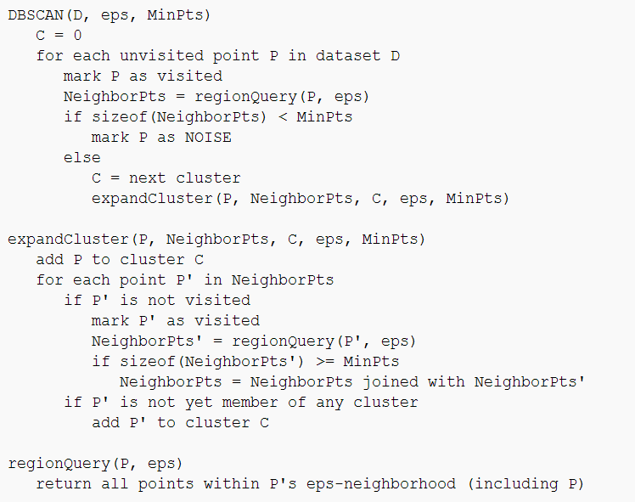
DBSCAN: The Algorithm

Slide 8
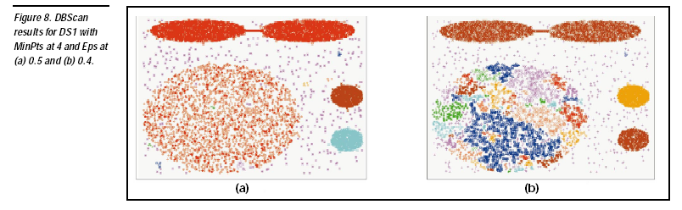

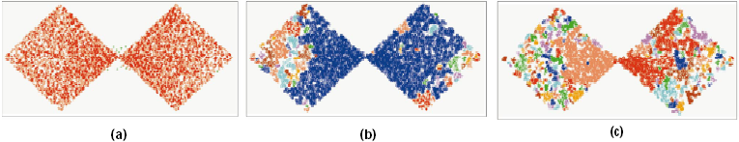
DBSCAN: Sensitive to Parameters

Slide 9
תרגיל

Slide 10
Clustering High-Dimensional Data
Clustering high-dimensional data
Many applications: text documents, DNA micro-array data
Major challenges:
Many irrelevant dimensions may mask clusters
Distance measure becomes meaningless—due to equi-distance
Clusters may exist only in some subspaces
Methods
Feature transformation: only effective if most dimensions are relevant
PCA & SVD useful only when features are highly correlated/redundant
Feature selection: wrapper or filter approaches
useful to find a subspace where the data have nice clusters
Subspace-clustering: find clusters in all the possible subspaces
CLIQUE, ProClus, and frequent pattern-based clustering

Slide 11
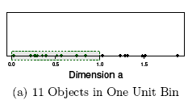
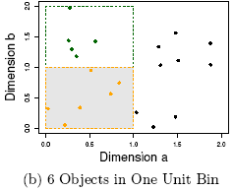
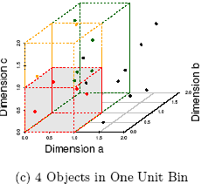
The Curse of Dimensionality (graphs adapted from Parsons et al. KDD Explorations 2004)
Data in only one dimension is relatively packed
Adding a dimension “stretch” the points across that dimension, making them further apart
Adding more dimensions will make the points further apart—high dimensional data is extremely sparse
Distance measure becomes meaningless—due to equi-distance

Slide 12
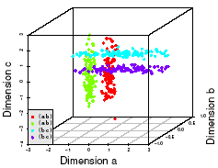
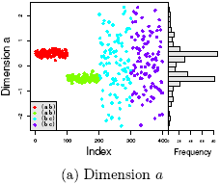
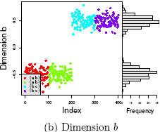
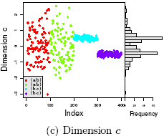
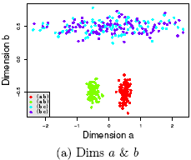
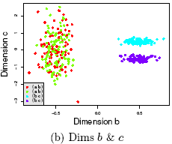
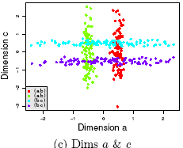
Why Subspace Clustering? (adapted from Parsons et al. SIGKDD Explorations 2004)
Clusters may exist only in some subspaces
Subspace-clustering: find clusters in all the subspaces

Slide 13
CLIQUE (Clustering In QUEst)
Agrawal, Gehrke, Gunopulos, Raghavan (SIGMOD’98)
Automatically identifying subspaces of a high dimensional data space that allow better clustering than original space
CLIQUE can be considered as both density-based and grid-based
It partitions each dimension into the same number of equal length interval
It partitions an m-dimensional data space into non-overlapping rectangular units
A unit is dense if the fraction of total data points contained in the unit exceeds the input model parameter
A cluster is a maximal set of connected dense units within a subspace

Slide 14
CLIQUE: The Major Steps
Partition the data space and find the number of points that lie inside each cell of the partition.
Identify the subspaces that contain clusters using the Apriori principle
Identify clusters
Determine dense units in all subspaces of interests
Determine connected dense units in all subspaces of interests.
Generate minimal description for the clusters
Determine maximal regions that cover a cluster of connected dense units for each cluster
Determination of minimal cover for each cluster

Slide 15
Salary (10,000)
Vacation(week)
7
7
6
6
5
5
4
4
3
3
2
2
1
1
0
age
0
age
20
30
40
50
60
20
30
40
50
60
τ = 3
Vacation
Salary
30
50
age

Slide 16
Why Constraint-Based Cluster Analysis?
Need user feedback: Users know their applications the best
Less parameters but more user-desired constraints, e.g., an ATM allocation problem: obstacle & desired clusters

Slide 17
A Classification of Constraints in Cluster Analysis
Clustering in applications: desirable to have user-guided (i.e., constrained) cluster analysis
Different constraints in cluster analysis:
Constraints on individual objects (do selection first)
Cluster on houses worth over $300K
Constraints on distance or similarity functions
Weighted functions, obstacles (e.g., rivers, lakes)
Constraints on the selection of clustering parameters
# of clusters, MinPts, etc.
User-specified constraints
Contain at least 500 valued customers and 5000 ordinary ones
Semi-supervised: giving small training sets as “constraints” or hints

Slide 18
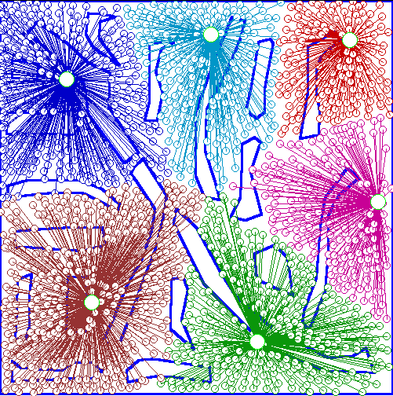
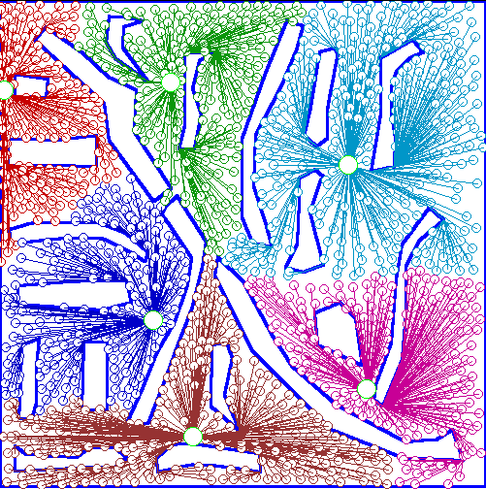
An Example: Clustering With Obstacle Objects
Not Taking obstacles into account
Taking obstacles into account

Slide 19
Clustering with User-Specified Constraints
Example: Locating k delivery centers, each serving at least m valued customers and n ordinary ones
Proposed approach
Find an initial “solution” by partitioning the data set into k groups and satisfying user-constraints
Iteratively refine the solution by micro-clustering relocation (e.g., moving δ μ-clusters from cluster C_{i} to C_{j}) and “deadlock” handling (break the microclusters when necessary)
Efficiency is improved by micro-clustering
How to handle more complicated constraints?
E.g., having approximately same number of valued customers in each cluster?! — Can you solve it?

Slide 20
Micro-Clustering
A Micro-Cluster is a set of individual data points that are close to each other and will be treated as a single unit in further offline Macro-clustering.
View of Micro-Cluster
View of Macro-Cluster

Slide 21
What Is Outlier Discovery?
What are outliers?
The set of objects are considerably dissimilar from the remainder of the data
Example: Sports: Michael Jordon, Wayne Gretzky, ...
Problem: Define and find outliers in large data sets
Applications:
Credit card fraud detection
Telecom fraud detection
Customer segmentation
Medical analysis

Slide 22
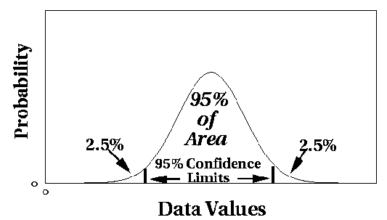
Outlier Discovery: Statistical Approaches
Assume a model underlying distribution that generates data set (e.g. normal distribution)
Use discordancy tests depending on
data distribution
distribution parameter (e.g., mean, variance)
number of expected outliers
Drawbacks
most tests are for single attribute
In many cases, data distribution may not be known

Slide 23
Outlier Discovery: Distance-Based Approach
Introduced to counter the main limitations imposed by statistical methods
We need multi-dimensional analysis without knowing data distribution
Distance-based outlier: A DB(p, D)-outlier is an object O in a dataset T such that at least a fraction p of the objects in T lies at a distance greater than D from O
Algorithms for mining distance-based outliers
Index-based algorithm
Nested-loop algorithm
Cell-based algorithm

Slide 24
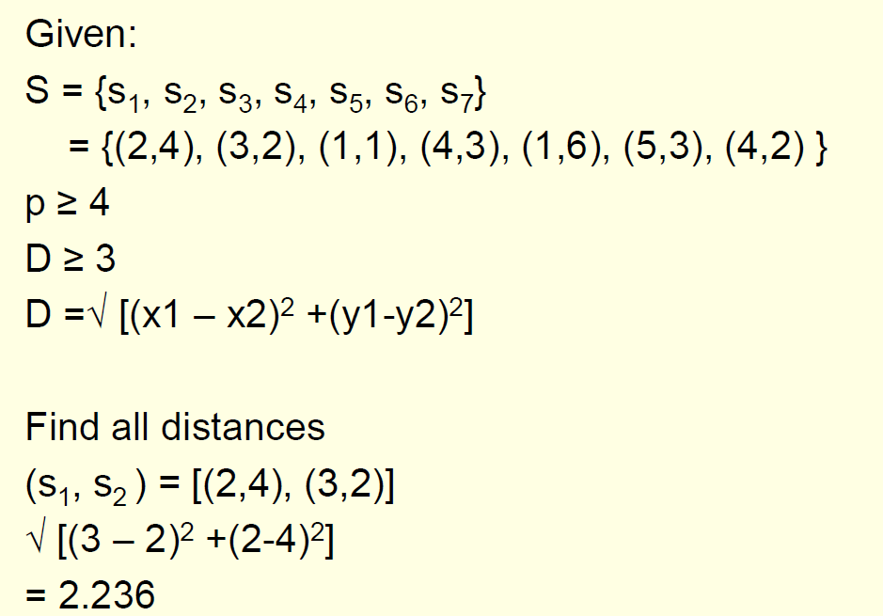
Distance-Based Outlier Detection Example

Slide 25
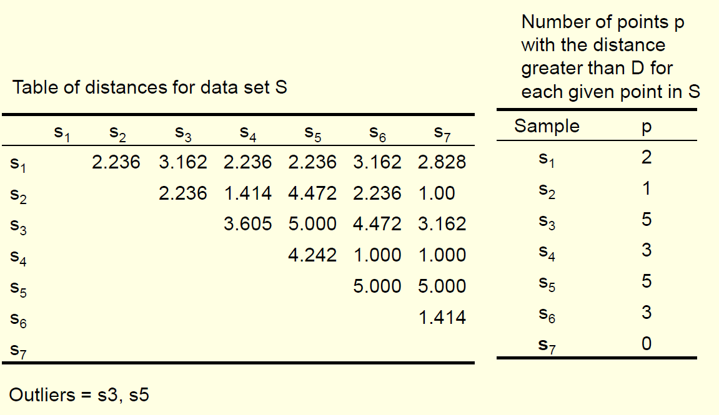
Distance-Based Outlier Detection Example

Slide 26
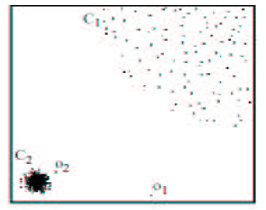
Density-Based Local Outlier Detection
Distance-based outlier detection is based on global distance distribution
It encounters difficulties to identify outliers if data is not uniformly distributed
Ex. C₁ contains 400 loosely distributed points, C₂ has 100 tightly condensed points, 2 outlier points o₁, o₂
Distance-based method cannot identify o₂ as an outlier
Need the concept of local outlier
Local outlier factor (LOF)
Assume outlier is not crisp
Each point has a LOF

Slide 27
Clustering - Summary
Cluster analysis groups objects based on their similarity and has wide applications
Measure of similarity can be computed for various types of data
Clustering algorithms can be categorized into partitioning methods, hierarchical methods, density-based methods, grid-based methods, and model-based methods
Outlier detection and analysis are very useful for fraud detection, etc. and can be performed by statistical, distance-based or deviation-based approaches
There are still lots of research issues on cluster analysis

Slide 28
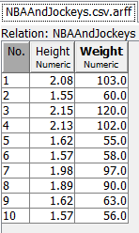
Clustering In Weka
We will run weka to find clusters in the following file containing data about the heights and weights of basketball players and jockeys

Slide 29
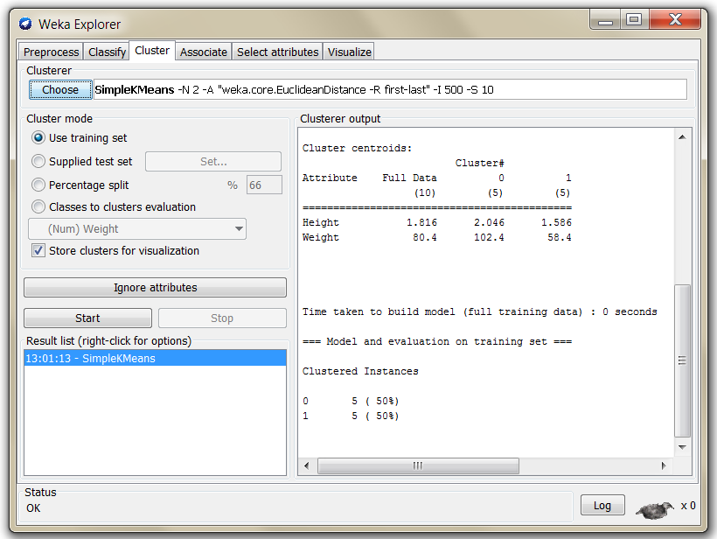
Choosing Clustering Algorithm

Slide 30
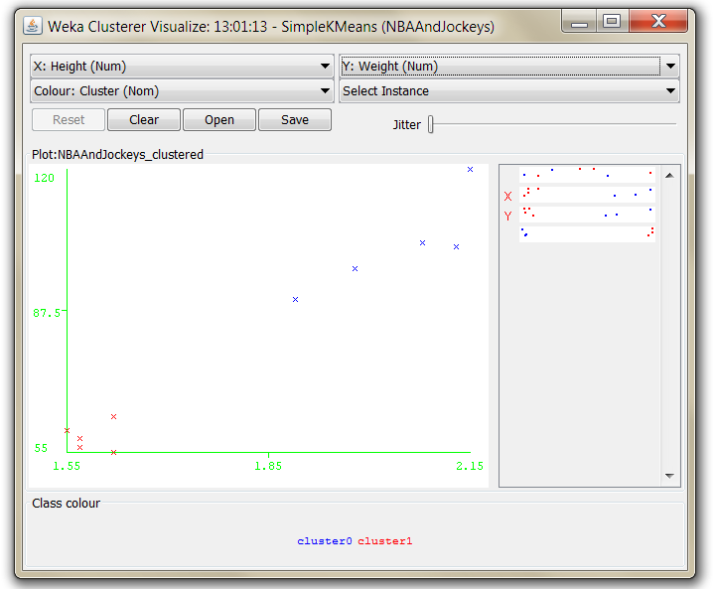
Visualize Results

Slide 31
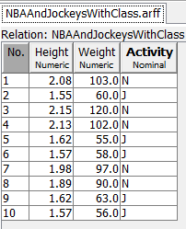
Clustering Evaluation
To evaulate the clustering results, we can supply Weka with a data file that contains the labeling of each sample

Slide 32
Clustering Evaluation
To evaulate the clustering results, we can supply Weka with a data file that contains the labeling of each sample

Slide 33
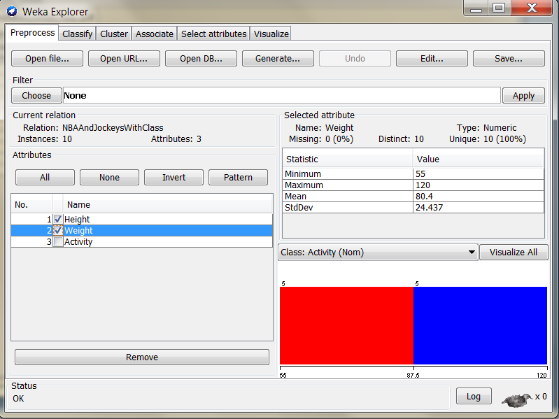
Clustering Evaluation
In the Preprocess tab choose just the columns needed for the clustering

Slide 34
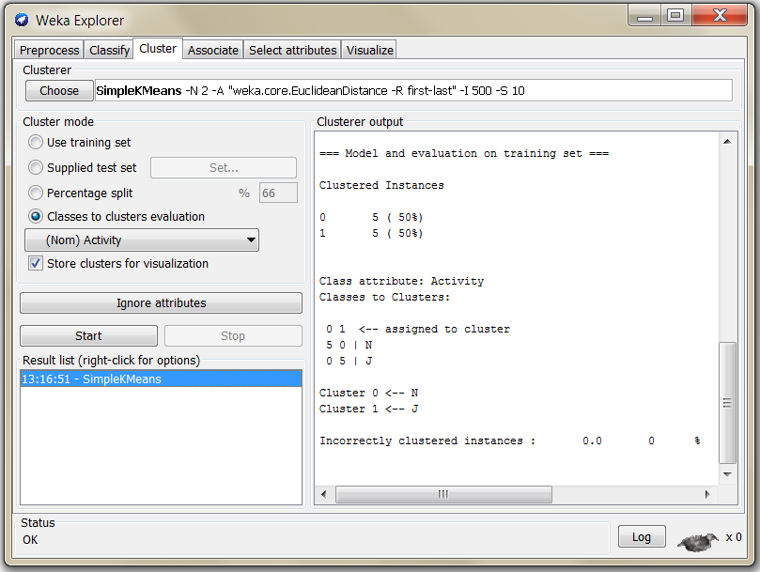
Clustering Evaluation
In the Cluster tab choose the attribute to be used for cluster evaluation (Activity in this case)

Slide 35

Mining Text Data
Data Mining / Knowledge Discovery
Structured Data Multimedia Free Text Hypertext
HomeLoan (
Loanee: Frank Rizzo
Lender: MWF
Agency: Lake View
Amount: $200,000
Term: 15 years
)
Frank Rizzo bought
his home from Lake
View Real Estate in
1992.
He paid $200,000
under a15-year loan
from MW Financial.
<a href>Frank Rizzo
</a> Bought
<a hef>this home</a>
from <a href>Lake
View Real Estate</a>
In <b>1992</b>.
<p>...
Loans($200K,[map],...)
35
Notes:
Throughout this course we have been discussing Data Mining over a variety of data types.
Two former types we covered were Structured Data (relational) and multimedia data.
Today and in the last class we have been discussing Data Mining over free text,
and our next section will cover hypertext, such as web pages.
Text mining is well motivated, due to the fact that much of the world’s data can be
found in free text form (newspaper articles, emails, literature, etc.). There is a
lot of information available to mine.
While mining free text has the same goals as data mining in general
(extracting useful knowledge/stats/trends), text mining must overcome
a major difficulty – there is no explicit structure.
Machines can reason will relational data well since schemas are explicitly available.
Free text, however, encodes all semantic information within natural language. Our
text mining algorithms, then, must make some sense out of this natural language
representation. Humans are great at doing this, but this has proved to be a problem for machines.

Slide 36
Applications of Text Mining
Classification of email documents to filter spam or to automatically sort messages into mail folders
News article classification
Webpage classification
Word sense disambiguation
Automatic text summarization
And many more…

Slide 37
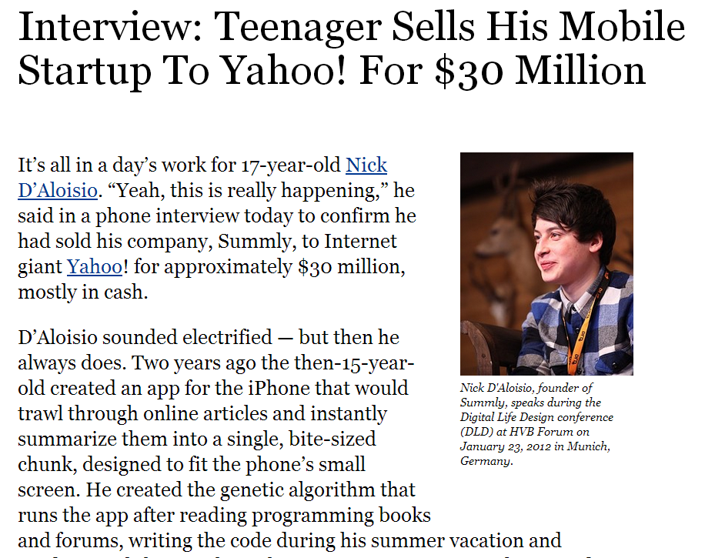
Example APP: Automatic Text Summarization

Slide 38
What Is Unique In Text Mining?
Feature Extraction
Very large number of features that represent each of the documents
The need for background knowledge
Even patterns supported by small number of documents may be significant
Huge number of patterns, hence need for visualization, interactive exploration

Slide 39
Text Representations
Characters
Words
n-grams
Linguistic Phrases
Keyphrases
Concepts
Frames
Parse Trees
Graphs

Slide 40
Bag-of-Tokens Approaches
Documents
Token Sets
Four score and seven years ago our fathers brought forth on this continent, a new nation, conceived in Liberty, and dedicated to the proposition that all men are created equal.
Now we are engaged in a great civil war, testing whether that nation, or …
nation – 5
civil - 1
war – 2
men – 2
died – 4
people – 5
Liberty – 1
God – 1
…
Feature
Extraction
Notes:
The previous text mining presentations “made sense” out of free text by
viewing text as a bag-of-tokens (words, n-grams). This is the same approach as IR.
Under that model we can already summarize, classify, cluster, and compute co-occurrence stats over free text.
These are quite useful for mining and managing large volumes of free text.
However, there is a potential to do much more. The BOT approach loses a LOT of information
contained in text, such as word order, sentence structure, and context. These are precisely the
features that humans use to interpret text.
Thus the natural question is can we do better?

Slide 41
Bag-Of-Tokens Representation
Each word corresponds to a dimension in the resulting data space and each document then becomes a vector consisting of non-negative values on each dimension
Let tf(d, t) denote the frequency of term t ∈ T in document d ∈ D
Then the vector representation of a document d is
t_{d} = (tf(d, t₁), . . . , tf(d, t_{m}))
Problem: the most frequent terms are not necessarily the most informative ones

Slide 42

Bag-Of-Tokens Representation
Solution: transform the basic term frequencies tf(d, t) into the tfidf (term frequency and inversed document frequency) weighting scheme
Tf idf weighs the frequency of a term t in a document d with a factor that discounts its importance with its appearances in the whole document collection
df(t) is the number of documents in which t appears

Slide 43

Similarity Measures
Before clustering, a similarity/distance measure must be determined
A standard distance metric between two vectors is their Euclidean distance
Given two documents d_{a} and d_{b} represented by their term vectors t_{a} and t_{b}, the Euclidean distance of the two documents is defined as:
Problem: sensitive to document length

Slide 44
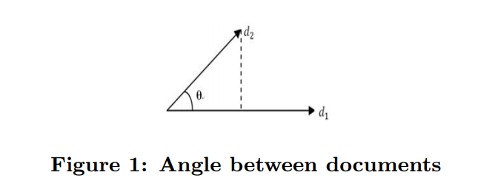
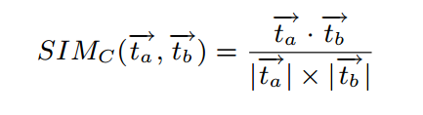
Similarity Measures
Cosine similarity is one of the most popular similarity measure applied to text documents
It measures the cosine of the angle between the document vectors
An important property of the cosine similarity is its independence of document length

Slide 45
Bag-Of-Tokens Representation
The problem with the bag-of-token representation is that it loses all order-specific information
Severely limits context!
More advanced representations use NLP techniques

Slide 46
Natural Language Processing
A dog is chasing a boy on the playground
Det
Noun
Aux
Verb
Det
Noun
Prep
Det
Noun
Lexical
analysis
(part-of-speech
tagging)
Noun Phrase
Noun Phrase
Complex Verb
Noun Phrase
Prep Phrase
Semantic analysis
Verb Phrase
Syntactic analysis
(Parsing)
Dog(d1).
Boy(b1).
Playground(p1).
Chasing(d1,b1,p1).
Verb Phrase
+
Sentence
Scared(x) if Chasing(_,x,_).
A person saying this may
be reminding another person to
get the dog back…
Scared(b1)
Inference
Pragmatic analysis
(speech act)
(Taken from ChengXiang Zhai, CS 397cxz – Fall 2003)
Notes:
NLP, or Computational Linguistics, is an entire field dedicated to the study
of automatically understanding free text. This field has been active since the 50’s.
General NLP attempts to understand document completely (at the level of a human reader).
There are several steps involved in NLP.
…Blah…

Slide 47
General NLP—Too Difficult!
Word-level ambiguity
“design” can be a noun or a verb (Ambiguous POS)
“root” has multiple meanings (Ambiguous sense)
Syntactic ambiguity
“natural language processing” (Modification)
“A man saw a boy with a telescope.” (PP Attachment)
Anaphora resolution
“John persuaded Bill to buy a TV for himself.”
(himself = John or Bill?)
Presupposition
“He has quit smoking.” implies that he smoked before.
Humans rely on context to interpret (when possible).
This context may extend beyond a given document!
(Taken from ChengXiang Zhai, CS 397cxz – Fall 2003)
Notes:
General NLP has proven to be too difficult. It is dubbed “AI-Complete”, meaning that such a
program would basically have to have near-human intelligence (i.e. solve AI).
The reason NLP in general is so difficult is that text is highly ambiguous. NL is meant for
human consumption and often contains ambiguities under the assumption that humans
will be able to develop context and interpret the intended meaning.
For instance [rewind], in this example the sentence could mean that either the dog, or the boy, or both
are on the playground. As a human we know that it is probably both, but that is due to our
knowledge that a dog is probably chasing close behind the boy, playgrounds are large,
they are probably playing, and a playground is a place to play. This background knowledge
probably is not contained in a document containing this sentence.
Despite such obstacles, computational linguists have made great progress on several subproblems.
We will now talk about four of these subproblems.

Slide 48
Shallow Linguistics
Progress on Useful Sub-Goals:
English Lexicon
Part-of-Speech Tagging
Word Sense Disambiguation
Phrase Detection / Parsing
Notes:
Several subgoals to NLP have been addressed to derive more info than just bag-of-tokens view.
English lexicon, POS Tagging, WSD, Parsing
Even with imperfect performance, these solutions already open the door for more intelligent text processing.

Slide 49
WordNet
An extensive lexical network for the English language
Contains over 138,838 words.
Several graphs, one for each part-of-speech.
Synsets (synonym sets), each defining a semantic sense.
Relationship information (antonym, hyponym, meronym …)
Downloadable for free (UNIX, Windows)
Expanding to other languages (Global WordNet Association)
Funded >$3 million, mainly government (translation interest)
Founder George Miller, National Medal of Science, 1991.
watery
parched
moist
wet
dry
arid
synonym
antonym
damp
anhydrous
Notes:
WordNet is an extensive lexical network for the human language.
Consists of a graph of synsets for each part of speech. Contains synonym and antonym relationships.
(hyponym=isa/subset, maple is a tree -> maple is a hyponym of tree)
(meronym=hasa, tree has a leaf -> leaf is a meronym of tree)
As will see, this is useful throughout NLP/ShallowLinguistics.
This encodes some of the lexicon that humans carry with them when interpreting text.

Slide 50
Part-of-Speech Tagging
Training data (Annotated text)
This sentence serves as an example of annotated text…
Det N V1 P Det N P V2 N
“This is a new sentence.”
POS Tagger
This is a new sentence.
Det Aux Det Adj N
Pick the most likely tag sequence.
Independent assignment
Most common tag
Partial dependency
(HMM)
(Adapted from ChengXiang Zhai, CS 397cxz – Fall 2003)
Notes:
POS Tagging attempts to label each word with the appropriate part of speech.
Past approaches were rule-based (manual, then learned). Current trend, however, is toward statistical approaches (HMM).
This shift is common throughout NLP, due to the ability of statistical approaches to robustly handle noise and/or unexpected events.
Conceptually statistical approaches are more fitting due to the fact that uncertainty is sometimes unavoidable (ambiguity).
Current algorithms (Brill’s Tagger, CLAWS taggers) report accuracy in the 97% range.

Slide 51
Word Sense Disambiguation
?
“The difficulties of computational linguistics are rooted in ambiguity.”
N Aux V P N
Supervised Learning
Features:
Neighboring POS tags (N Aux V P N)
Neighboring words (linguistics are rooted in ambiguity)
Stemmed form (root)
Dictionary/Thesaurus entries of neighboring words
High co-occurrence words (plant, tree, origin,…)
Other senses of word within discourse
Algorithms:
Rule-based Learning (e.g. IG guided)
Statistical Learning (i.e. Naïve Bayes)
Unsupervised Learning (i.e. Nearest Neighbor)
Notes:
WSD attempts to resolve ambiguity by labeling each word with a precise sense, as intended in the document.
This is typically performed after POS tagging, since POS tags are quite useful for WSD.
Current approaches address this as a supervised learning problem.
Features include neighboring words w/ POS tags, stemmed form of word, high co-occurrence words (with stem).
Quite a few supervised learning algorithms have been applied (rule-lists, bayesian, NN).
Performance depends heavily upon the particular text, but from what I’ve read 90%+ accuracy is common.

Slide 52
Parsing
Choose most likely parse tree…
S
Probability of this tree=0.000015
Probabilistic CFG
NP
VP
S→ NP VP
NP → Det BNP
NP → BNP
NP→ NP PP
BNP→ N
VP → V
VP → Aux V NP
VP → VP PP
PP → P NP
V → chasing
Aux→ is
N → dog
N → boy
N→ playground
Det→ the
Det→ a
P → on
Det
BNP
1.0
VP
PP
0.3
0.4
0.3
A
N
Aux
V
NP
P
NP
Grammar
dog
is
chasing
on
…
a boy
.
the playground
.
…
.
S
Probability of this tree=0.000011
1.0
NP
VP
0.01
Det
BNP
Aux
V
NP
PP
0.003
A
N
is
chasing
NP
Lexicon
P
NP
…
dog
a boy
on
…
the playground
(Adapted from ChengXiang Zhai, CS 397cxz – Fall 2003)
Notes:
Parsing attempts to infer the precise grammatical relationships between different words in a given sentence.
For example, POS are grouped into phrases and phrases are combined into sentences.
Approaches include parsing with probabilistic CFG’s, “link dictionaries”, and tree adjoining techniques (super-tagging).
Current techniques can only parse at the sentence level, in some cases reporting accuracy in the 90% range.
Again, the performance heavily depends upon the grammatical correctness and the degree of ambiguity of the text.

Slide 53
Text Classification
Motivation
Automatic classification for the large number of on-line text documents (Web pages, e-mails, corporate intranets, etc.)
Classification Process
Data preprocessing
Definition of training set and test sets
Creation of the classification model using the selected classification algorithm
Classification model validation
Classification of new/unknown text documents
Text document classification differs from the classification of relational data
Document databases are not structured according to attribute-value pairs

Slide 54
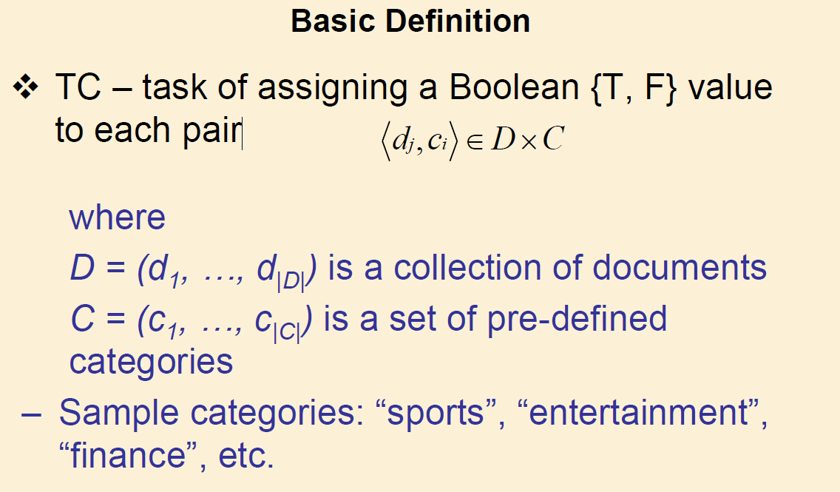
Text Classification

Slide 55
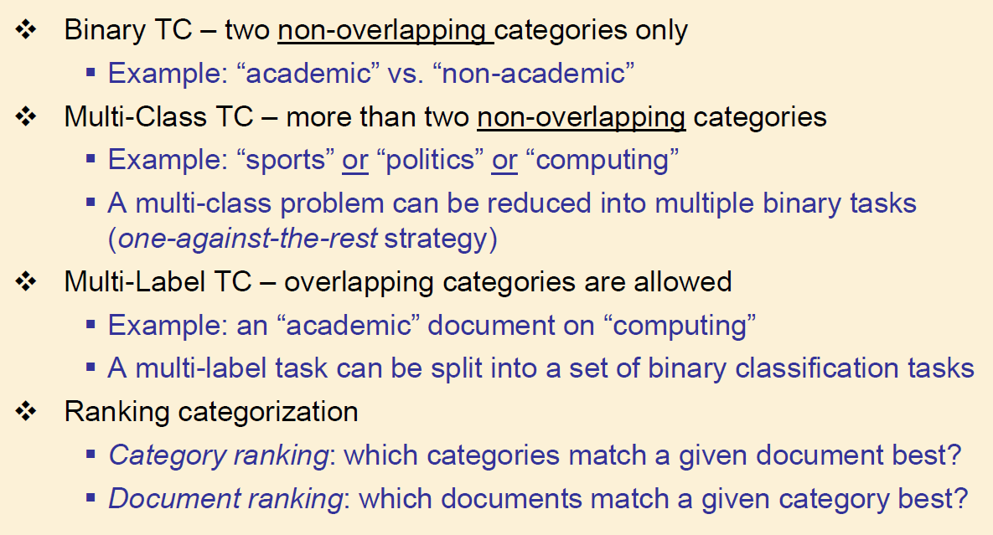
Text Classification Tasks

Slide 56
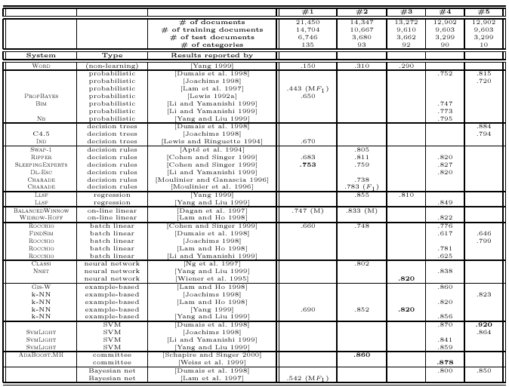
Text Classification(2)
Classification Algorithms:
K-Nearest Neighbors
Naïve Bayes
Neural Networks
Support Vector Machines
Decision Trees
Association rule-based
Boosting

Slide 57
Document Clustering
Motivation
Automatically group related documents based on their contents
No predetermined training sets or taxonomies
Generate a taxonomy at runtime
Clustering Process
Data preprocessing: remove stop words, stem, feature extraction, lexical analysis, etc.
Hierarchical clustering: compute similarities applying clustering algorithms.
Model-Based clustering (Neural Network Approach): clusters are represented by “exemplars”. (e.g.: SOM)

Slide 58
Text Categorization
Pre-given categories and labeled document examples (Categories may form hierarchy)
Classify new documents
A standard classification (supervised learning ) problem
Sports
Business
Education
Science
Categorization
System
…
…
Sports
Business
Education

Slide 59
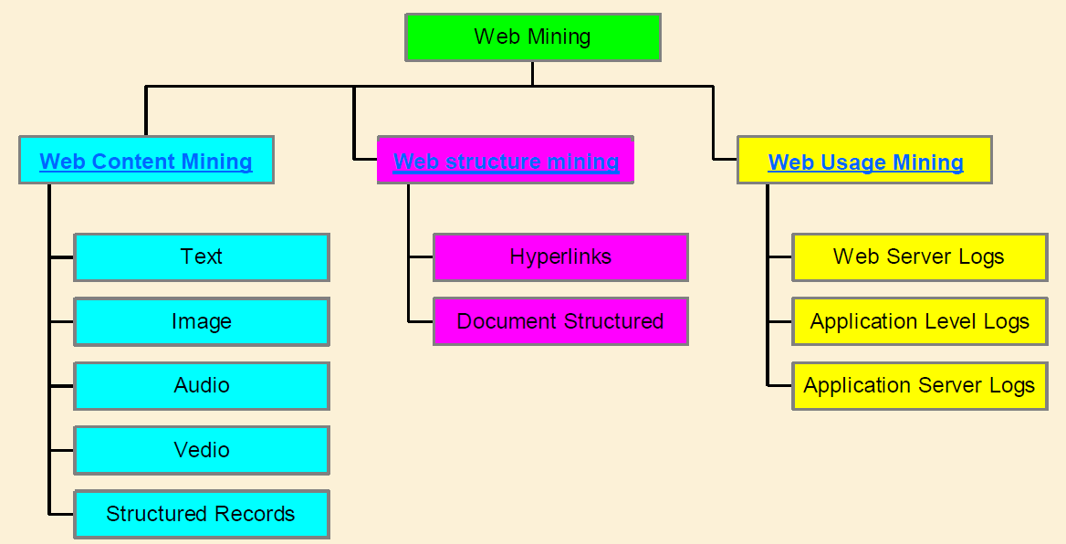
Web Mining Tasks
Web mining – the application of data mining techniques to extract knowledge from web content, structure and page

Slide 60
The Web: Opportunities & Challenges
Web offers an unprecedented opportunity and challenge to data mining
The amount of information on the Web is huge and easily accessible
The coverage of Web information is very wide and diverse. One can find information about almost anything.
Information/data of almost all types exist on the Web, e.g., structured tables, texts, multimedia data, etc.
The Web is noisy. A Web page typically contains a mixture of many kinds of information, e.g., main contents, advertisements, navigation panels, copyright notices, etc.
The Web is dynamic. Information on the Web changes constantly. Keeping up with the changes and monitoring the changes are important issues.

Slide 61
Search Engine – Two Rank Functions
Ranking based on link structure analysis
Search
Rank Functions
Importance Ranking
(Link Analysis)
Similarity based on content or text
Relevance Ranking
Backward Link
Web Topology
(Anchor Text)
Graph
Inverted
Indexer
Index
Anchor Text
Web Graph
Generator
Constructor
Term Dictionary
Meta Data
Forward
Forward
URL
(Lexicon)
Index
Link
Dictioanry
Web Page Parser
Web Pages

Slide 62
Relevance Ranking
Inverted index
- A data structure for supporting text queries
- like index in a book
aalborg 3452, 11437, …..
.
.
.
.
.
arm 4, 19, 29, 98, 143, ...
armada 145, 457, 789, ...
armadillo 678, 2134, 3970, ...
armani 90, 256, 372, 511, ...
.
.
.
.
.
zz 602, 1189, 3209, ...
indexing
disks with
documents
inverted index

Slide 63
PageRank
PageRank is a link analysis algorithm, named after Larry Page and used by the Google web search engine
The algorithm assigns a numerical weighting to each element of a hyperlinked set of documents with the purpose of "measuring" its relative importance within the set.
The numerical weight that it assigns to any given element E is referred to as the PageRank of E and denoted by PR(E)

Slide 64
PageRank
A hyperlink to a page counts as a vote of support.
The PageRank of a page is defined recursively and depends on the number and PageRank metric of all pages that link to it ("incoming links").
A page that is linked to by many pages with high PageRank receives a high rank itself.
If there are no links to a web page, then there is no support for that page.

Slide 65
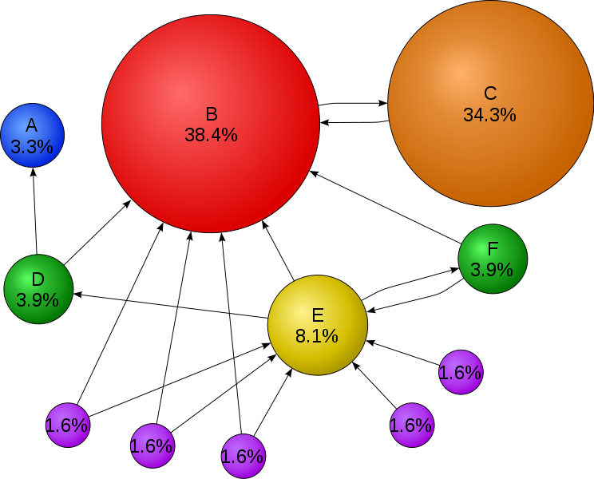
PageRank

Slide 66
Algorithm
PageRank is a probability distribution used to represent the likelihood that a person randomly clicking on links will arrive at any particular page.
The PageRank computations require several passes, called "iterations", through the collection of documents to adjust approximate PageRank values to more closely reflect the theoretical true value.
A probability is expressed as a numeric value between 0 and 1.
A 0.5 probability is commonly expressed as a "50% chance" of something happening. Hence, a PageRank of 0.5 means there is a 50% chance that a person clicking on a random link will be directed to the document with the 0.5 PageRank.

Slide 67
Algorithm
PageRank is a probability distribution used to represent the likelihood that a person randomly clicking on links will arrive at any particular page.
The PageRank computations require several passes, called "iterations", through the collection of documents to adjust approximate PageRank values to more closely reflect the theoretical true value.
A probability is expressed as a numeric value between 0 and 1.
A 0.5 probability is commonly expressed as a "50% chance" of something happening. Hence, a PageRank of 0.5 means there is a 50% chance that a person clicking on a random link will be directed to the document with the 0.5 PageRank.

Slide 68
Simplified Algorithm
Assume a small universe of four web pages: A, B, C and D.
Links from a page to itself, or multiple outbound links from one single page to another single page, are ignored.
PageRank is initialized to the same value for all pages. Hence the initial value for each page is 0.25.
The PageRank transferred from a given page to the targets of its outbound links upon the next iteration is divided equally among all outbound links.
If the only links in the system were from pages B, C, and D to A, each link would transfer 0.25 PageRank to A upon the next iteration, for a total of 0.75.

Slide 69

Simplified Algorithm
Suppose instead that page B had a link to pages C and A, while page D had links to all three pages.
Thus, upon the next iteration, page B would transfer half of its existing value, or 0.125, to page A and the other half, or 0.125, to page C.
Since D had three outbound links, it would transfer one third of its existing value, or approximately 0.083, to A.

Slide 70
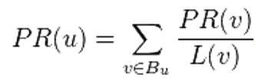
Simplified Algorithm
In the general case, the PageRank value for any page u can be expressed as:
i.e. the PageRank value for a page u is dependent on the PageRank values for each page v contained in the set B_{u} (the set containing all pages linking to page u), divided by the number L(v) of links from page v.

Slide 71
Damping Factor
The PageRank theory holds that an imaginary surfer who is randomly clicking on links will eventually stop clicking.
The probability, at any step, that the person will continue is a damping factor d.
Various studies have tested different damping factors, but it is generally assumed that the damping factor will be set around 0.85.
The damping factor is subtracted from 1 and the result is divided by the number of documents (N) in the collection and this term is then added to the product of the damping factor and the sum of the incoming PageRank scores.

Slide 72
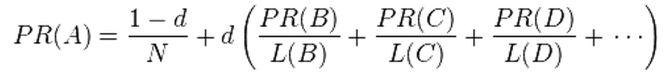
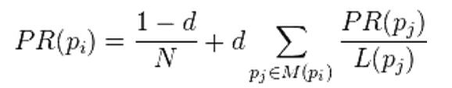
Damping Factor
or more generally

Slide 73

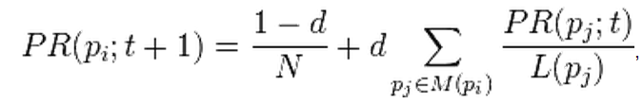
Computation
PageRank can be computed either iteratively or algebraically
Iterative – at t = 0, an initial probability distribution is assumed, usually
At each time step, the computation, as detailed above, yields
Computation ends when the difference between the page ranks in two consecutive iterations is less than epsilon

